Slide 1

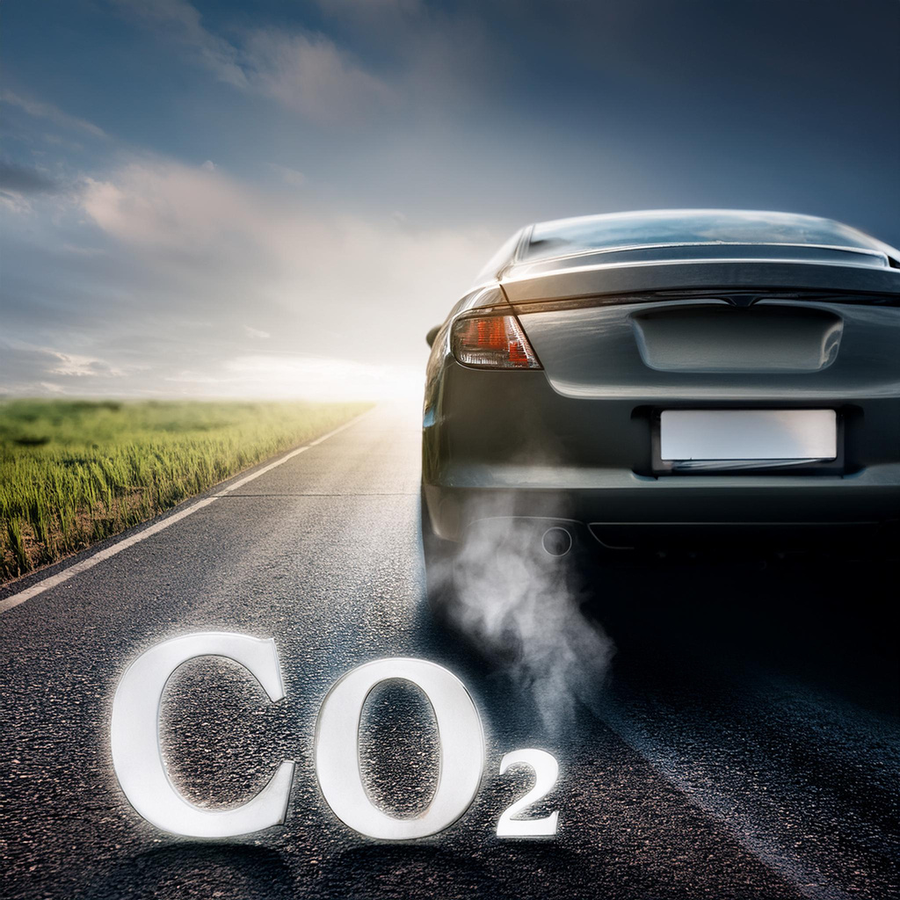





CO2 Emission Prediction From Vehicles

Slide 2








Team Members
Dhiraj Mahato
Rohit Dey
Anudipta Das
Ishita Karmakar
Rishov Ghosh
Sayed Rahaman

Slide 3

Overview
Introduction
Problem Identification
Tools used for Analysis
Data Collection
Data Cleaning
Data Analysis
Data Modeling
Hypothesis Development
Solution Design
Visualization (Power BI)
Conclusion
References

Slide 4
Introduction
This project is a data-driven initiative with which we aim to completely analyze the complex interplay between various factors (e.g., engine size, cylinder count, fuel consumption) and CO2 emissions from different vehicles.
Our goal is to develop a machine learning model that generates precise CO2 emission predictions based on vehicle attributes.
In order to comprehend the effects of regulatory changes and technology improvements on environmental sustainability, the primary objective of this study is to analyze trends in vehicle CO2 emissions.

Slide 5



Problem Identification
Relevant SDGs
Problem Statement
Significance of the Problem
SDG 3: Good Health and Well-Being
Reducing vehicle emissions improves air quality, directly impacting public health.
SDG 7: Affordable and Clean Energy
The project relates to improving energy efficiency in transportation.
SDG 9: Industry, Innovation and Infrastructure
Insights from the analysis can drive innovation in automotive technology and transportation infrastructure.
SDG 11: Sustainable Cities and Communities
Reducing vehicle emissions is key to creating more sustainable urban environments.
SDG 13: Climate Action
Addressing vehicle CO2 emissions is directly relevant to climate change mitigation efforts.
The CO2 emissions from vehicles have a major impact on both climate change and greenhouse gas emissions worldwide.
In order to anticipate emissions in future vehicle designs, it is imperative to comprehend the components controlling vehicle CO2 emissions.
In order to make well-informed decisions, research examines CO2 emissions across different vehicle types.
Climate change mitigation: Reducing vehicle emissions is crucial for mitigating global CO2 emissions.
Air quality and public health: Lowering vehicle emissions can improve air quality and health outcomes.
Policy development: Data-driven insights inform fuel efficiency policies and incentives for low-emission vehicles.
Consumer awareness: Clear vehicle emissions information aids environmentally conscious purchasing decisions.
Automotive industry impact: Understanding emission trends drives innovation towards fuel-efficient and low-emission vehicle technologies.

Slide 6




Tools used for Analysis
01
02
Python
Jupyter Notebook
For data cleaning, analysis, and visualization, using libraries such as Pandas, NumPy, Matplotlib, Seaborn and Scikit-learn.
For documenting the analysis process and visualizations.
03
Power BI
For developing interactive
visualizations and dashboards.

Slide 7
Libraries used in Python
1
Pandas
Seaborn
4
2
NumPy
Scikit-learn
5
3
Matplotlib

Slide 8

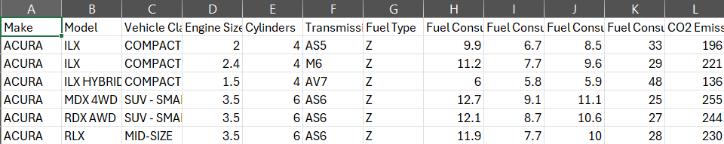

Data Collection
Name of Dataset:
CO2 Emission by Vehicles
Source:
Kaggle
Link:
Click Here
Snapshot of Dataset:

Slide 9


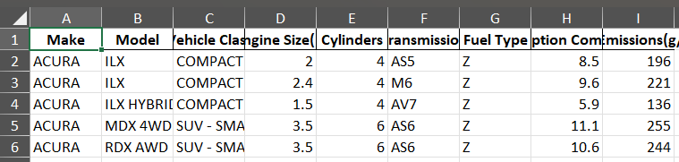


Data Cleaning
Dropping Unnecessary Columns
Formatting Model Column Values to Upper Case
Dropping Duplicates
Snapshot of Cleaned Dataset:

Slide 10

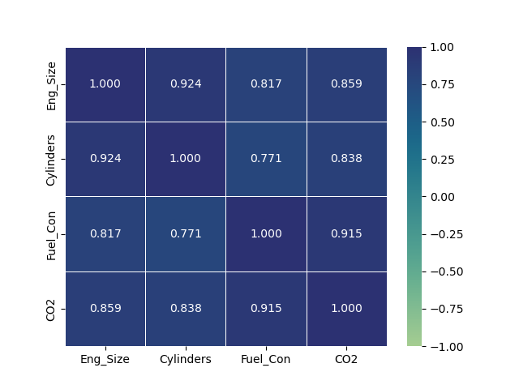

Data Analysis
Correlation heatmap of the numerical features
Parameters needed for CO2 emission prediction in decreasing order of importance are:
Fuel Consumption
Engine Size
Cylinders

Slide 11
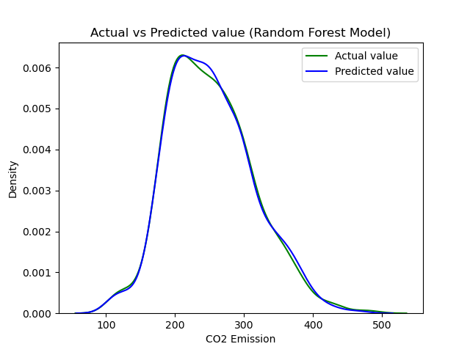

Random Forest Model
Attributes Taken:
Fuel Consumption
Engine Size
Cylinder Count
Model Accuracy:
96.59%
Training Sample Size:
2173
Testing Sample Size:
932

Slide 12



Hypothesis Development
Adoption of advanced fuel-efficient technologies and increased EV use:
Substantially decrease CO2 emissions from transportation over the years.
Detailed analysis will:
Reveal specific temporal and spatial patterns in CO2 emissions.
These patterns can be mitigated through:
Focused policy measures.
Targeted infrastructure development

Slide 13



Solution
Design
Proposed Solution
Implementation Plan
Alignment with SDG’s

Slide 14


01 Proposed Solution
Objective: Develop a machine learning model to predict CO2 emissions based on vehicle mpg, cylinder count, and engine size.
Impact: This solution helps manufacturers design more fuel-efficient vehicles, aids policymakers in enforcing environmental regulations, and raises public awareness about emissions.

Slide 15





02 Implementation Plan
Data Collection
Data Preprocessing
Feature Engineering
Model Evaluation
Model Selection and Training

Slide 16



03 Alignment with SDGs
SDG 3: Good Health and Well-Being
SDG 7: Affordable and Clean Energy
SDG 9: Industry, Innovation and Infrastructure
SDG 11: Sustainable Cities and Communities
SDG 13: Climate Action

Slide 17

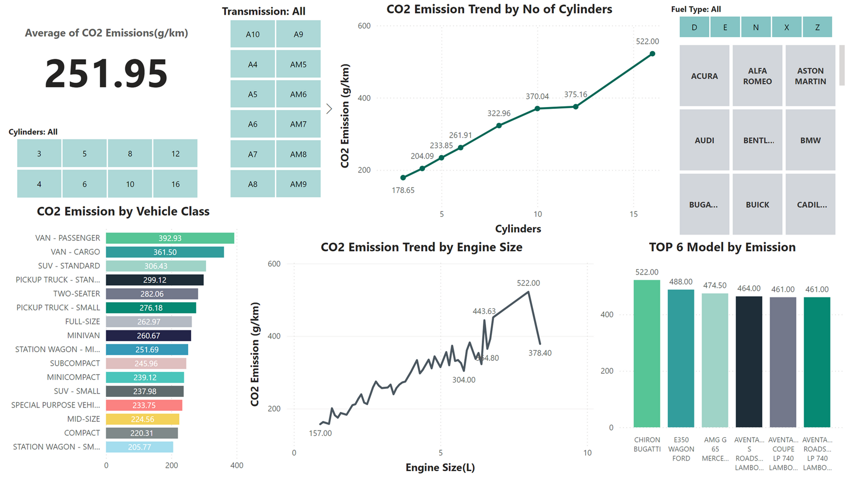

Power BI Dashboard
Dashboard link

Slide 18


Conclusion
In conclusion, this project marks a crucial step toward a sustainable automotive industry through data-driven CO2 emission analysis and solutions. It promises to influence vehicle design, policy-making, and public awareness, driving significant reductions in automotive emissions.
In future, we want to expand our work to include more vehicle types, integrate real-time data, and explore AI-driven predictive models. Potential also exists for synergies with smart city initiatives to further optimize emissions reduction in the transport sector. We also integrate the model as a Website.
Project Link (Github)

Slide 19
References
Data source:
Kaggle
Tools used:
Python
Jupyter Notebook
Power BI

Slide 20

THANK YOU

